Slide 1
Machine Learning Fundamentals
UIUC ECON 490: Applied Machine Learning in Economics

Slide 2

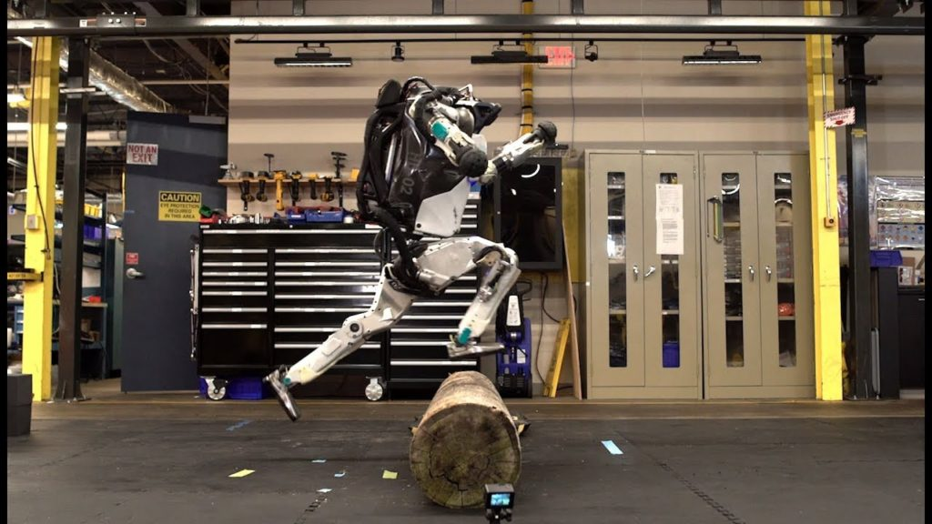
What is learning?
Given an input, produce correct output
Taught via reinforcement

Slide 3
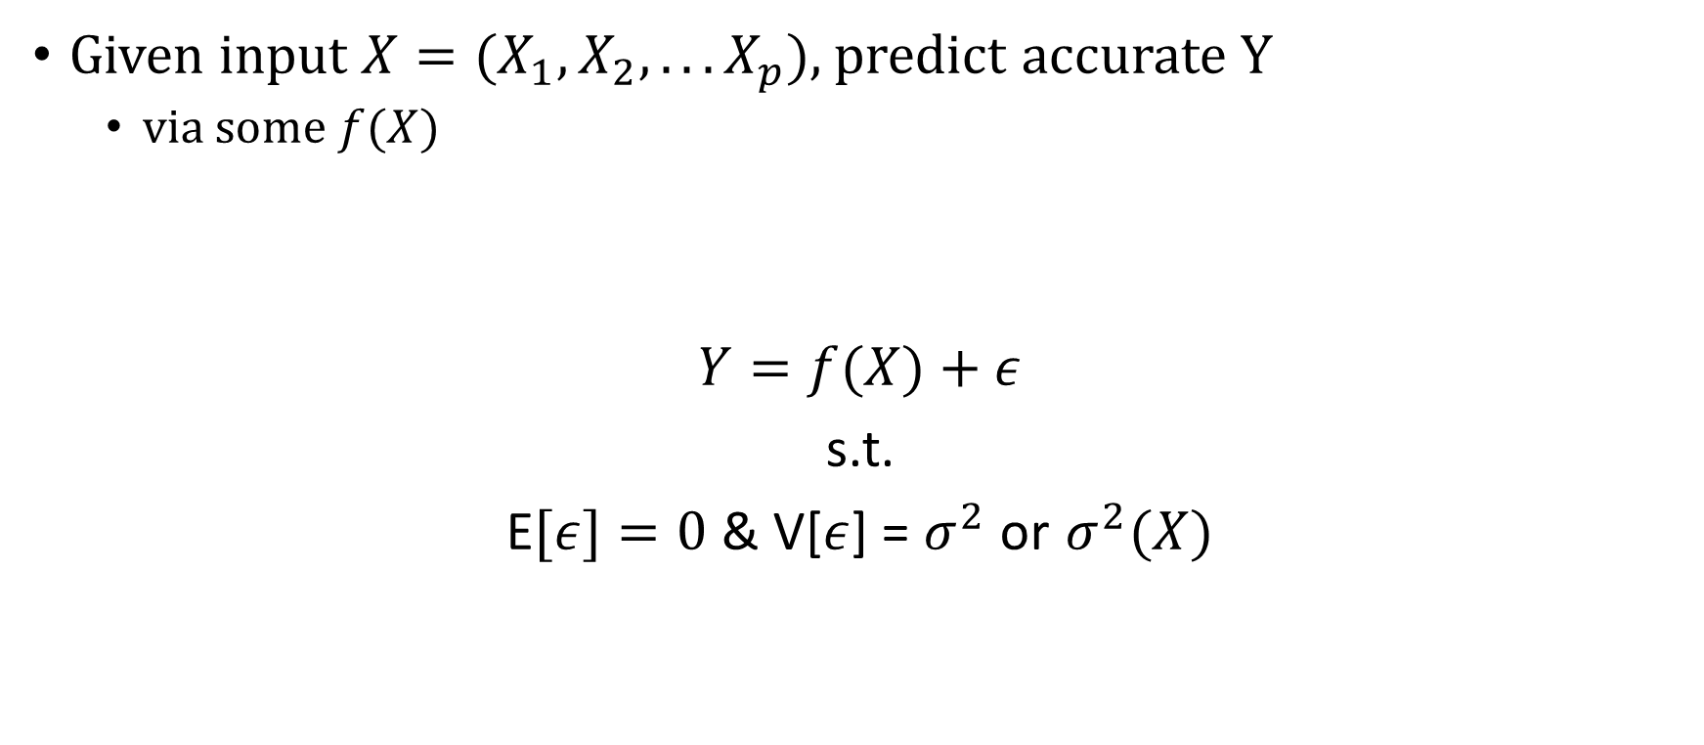
Machine Learning
Given input $X=(X_{1},X_{2},...X_{p})$, predict accurate Y
via some $f(X)$
$Y=f(X)+ε$
s.t.
E$[ε]=0$ & V[$ε$] = $σ^{2}$ or $σ_{ }^{2}(X)$

Slide 4
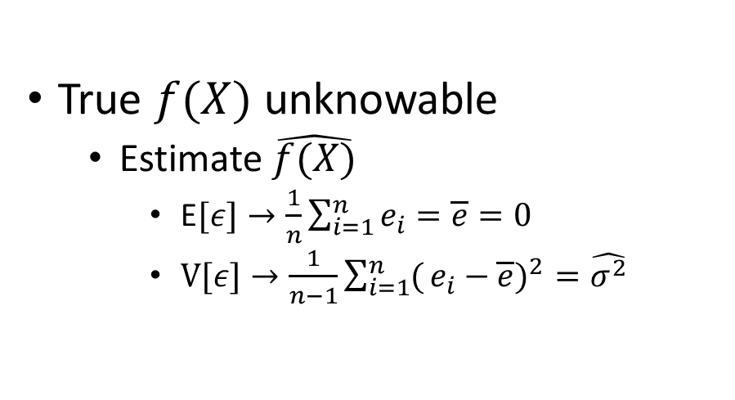
In Practice
True $f(X)$ unknowable
Estimate $\hat{f(X)}$
E$[ε]→\frac{1}{n}\sum_{i=1}^{n}{e_{i}}=\overline{e}=0$
V$[ε]→\frac{1}{n−1}\sum_{i=1}^{n}{(}e_{i}−\overline{e})^{2}$ $=\hat{σ^{2}}$
Permits:
Prediction
Inference

Slide 5
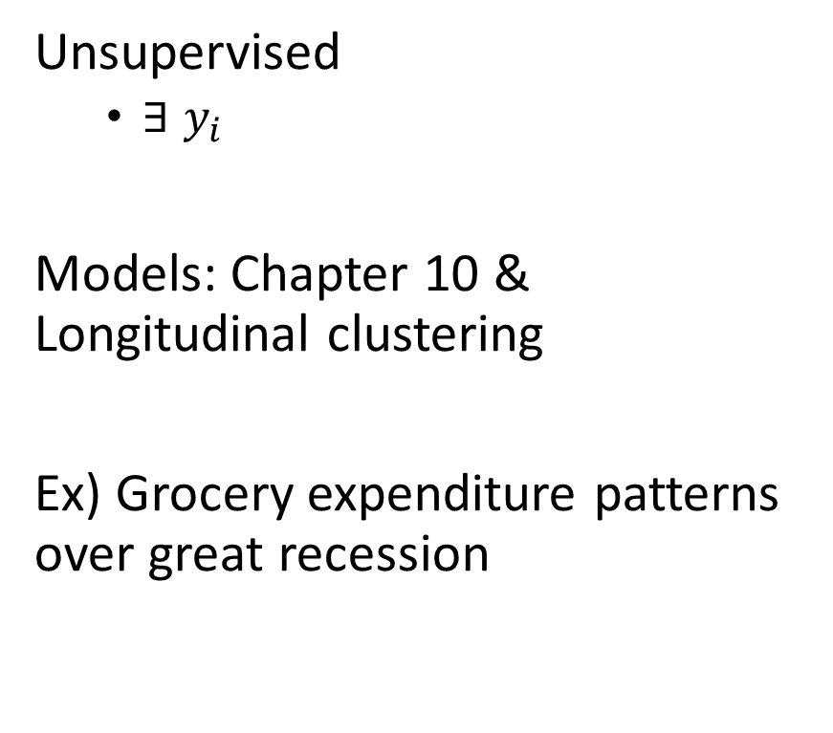
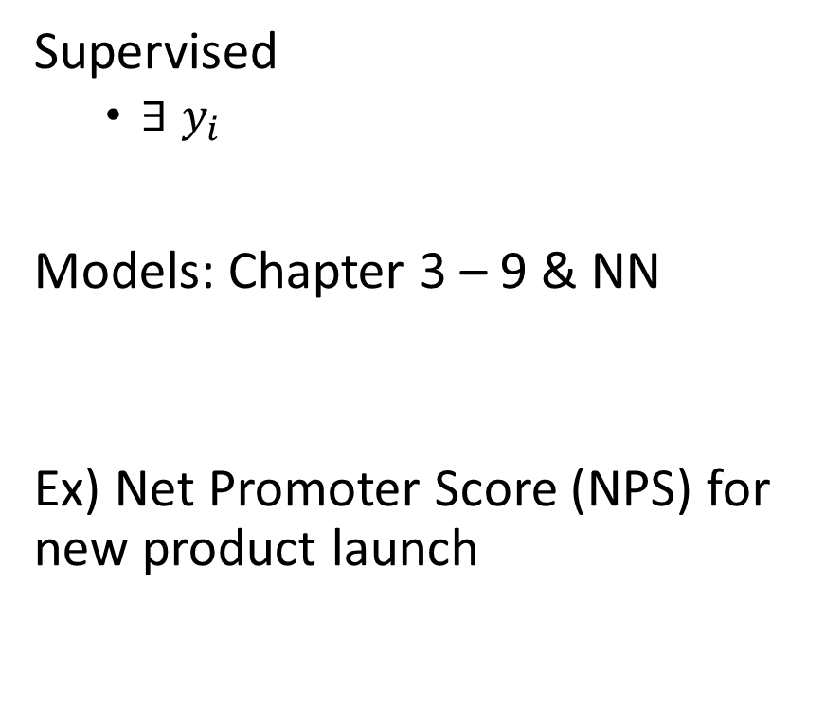
Types of Learning
Supervised
$∃ y_{i}$
Models: Chapter 3 – 9 & NN
Ex) Net Promoter Score (NPS) for new product launch
Unsupervised
$∃ y_{i}$
Models: Chapter 10 & Longitudinal clustering
Ex) Grocery expenditure patterns over great recession

Slide 6
Types of Models
Parametric
Assume data generating process (DGP) is a distribution (with parameters, i.e. normal)
Ex) OLS, L/QDA, Multinomial Regression
Pros
Interpretation
Speed
Less Data
Cons
Constrained
Limited Complexity
Poor fit
Non-parametric
No assumptions about DGP
Ex) KNN, Splines, Random forests
Pros
Flexibility
Fewer restrictions
Accuracy
Cons
More data
Slower
Overfitting

Slide 7
Interpretation vs. Flexibility
About variables
Goal:
Inference
Interpretable-inflexible models
Ex) OLS, KNN, LDA/QDA, regularization
Prediction
Opaque-flexible models
Ex) NN, SVM, Spline, Bagging/Boosting RF

Slide 8
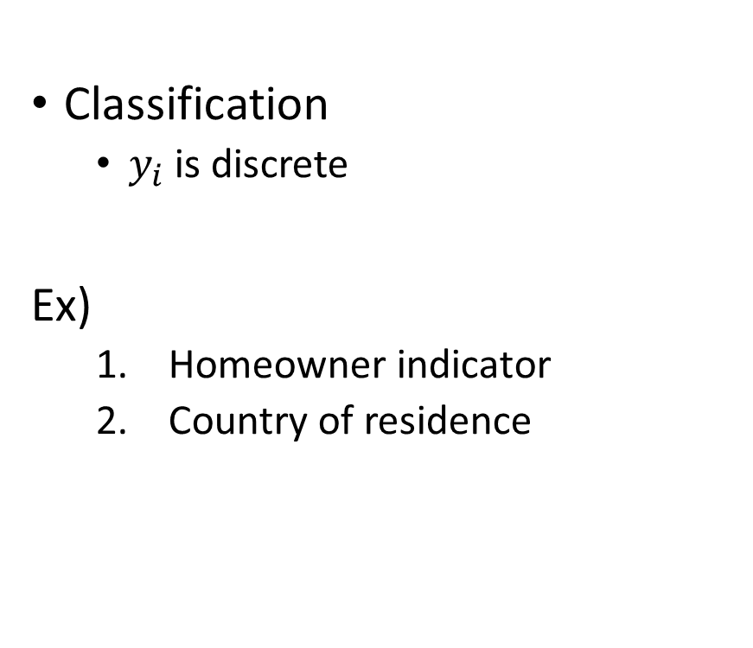
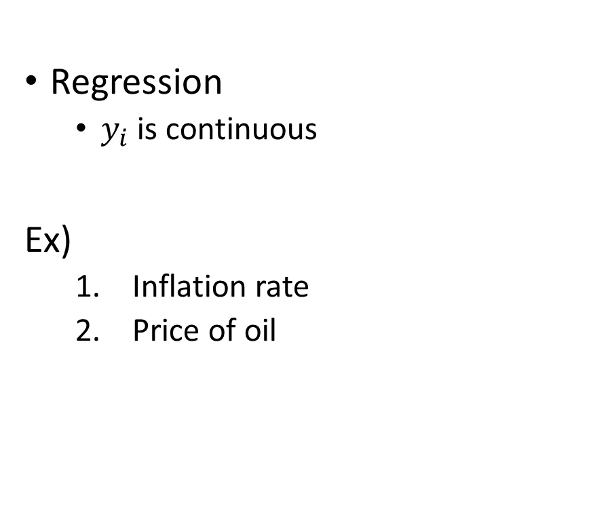
Types of Problems
Regression
$y_{i}$ is continuous
Ex)
Inflation rate
Price of oil
Classification
$y_{i}$ is discrete
Ex)
Homeowner indicator
Country of residence

Slide 9
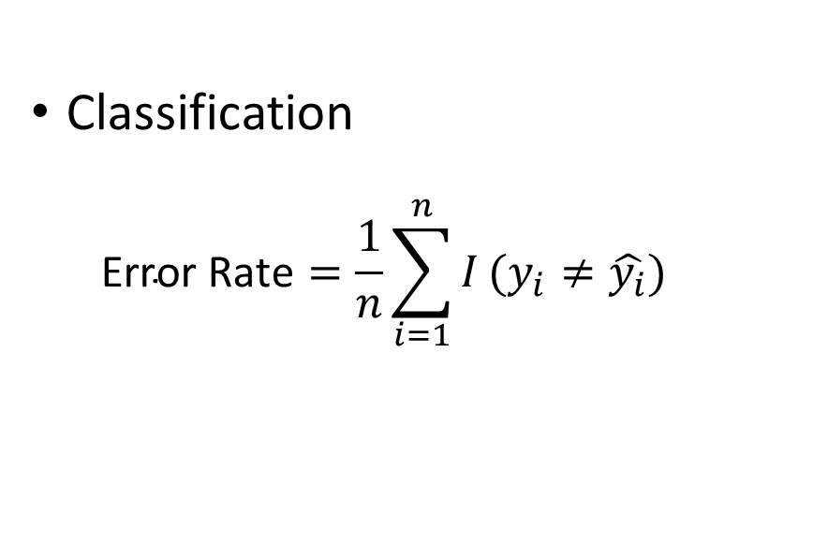
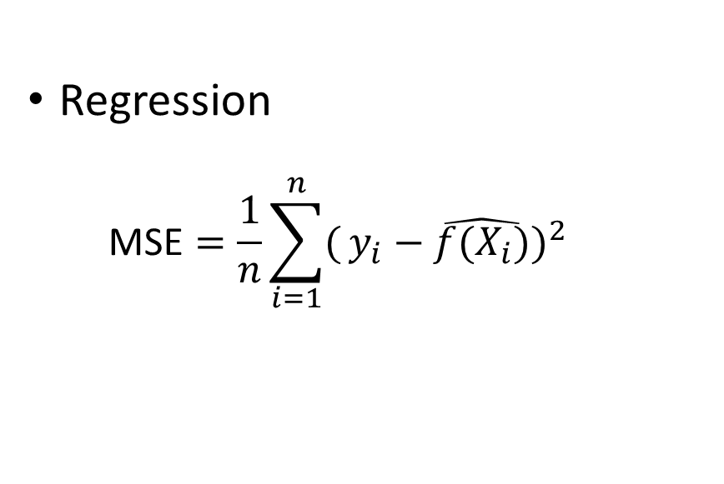
Model Accuracy
Regression
$$\text{MSE}=\frac{1}{n}\sum_{i=1}^{n}{(}y_{i}−\hat{f(X_{i})})^{2}$$
Classification
$$\text{Error} \text{Rate}=\frac{1}{n}\sum_{i=1}^{n}{I}(y_{i}≠\hat{y_{i}})$$

Slide 10
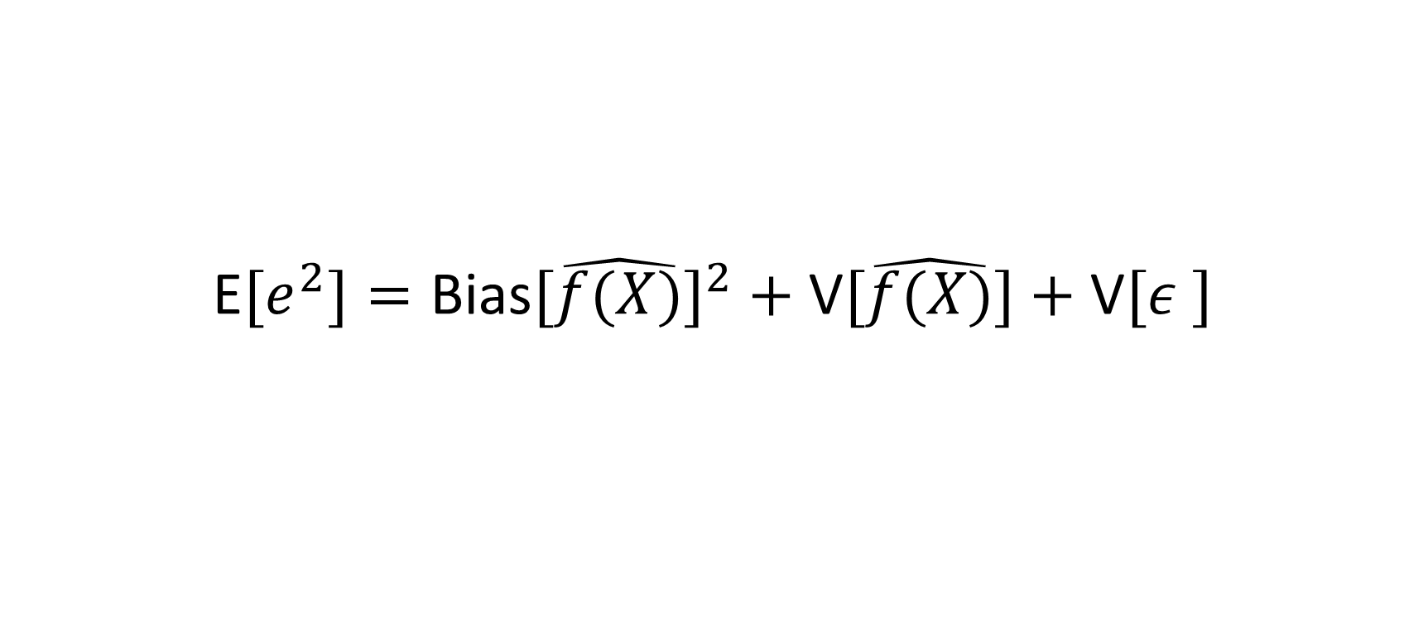
Bias-variance Tradeoff
E$[e_{ }^{2}]=\text{Bias}[\hat{f(X)}]^{2}+\text{V}[\hat{f(X)}]+\text{V}[ε_{ }^{ }]$

